Slide 1

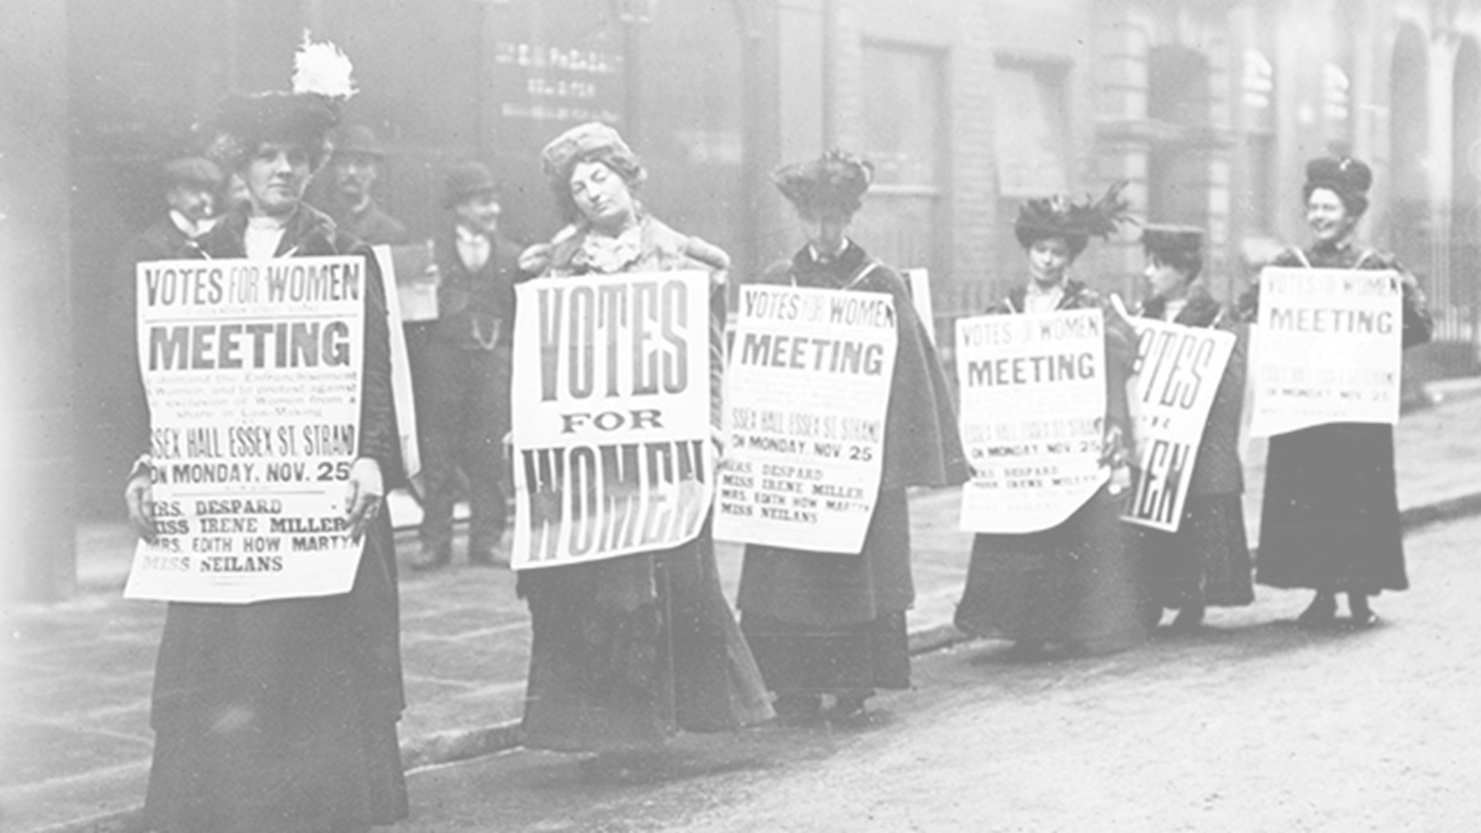


1900-2000
Chapter 29
WOMEN IN 20TH CENTURY IRELAND
women in 20th century ireland
2.1 RECOGNISE how a pattern of settlement and plantation influenced identity on the island of Ireland, referring to one example of a pattern of settlement, such as the growth of towns, and one plantation
Strand Two: The History of Ireland
@MsDoorley

Slide 2

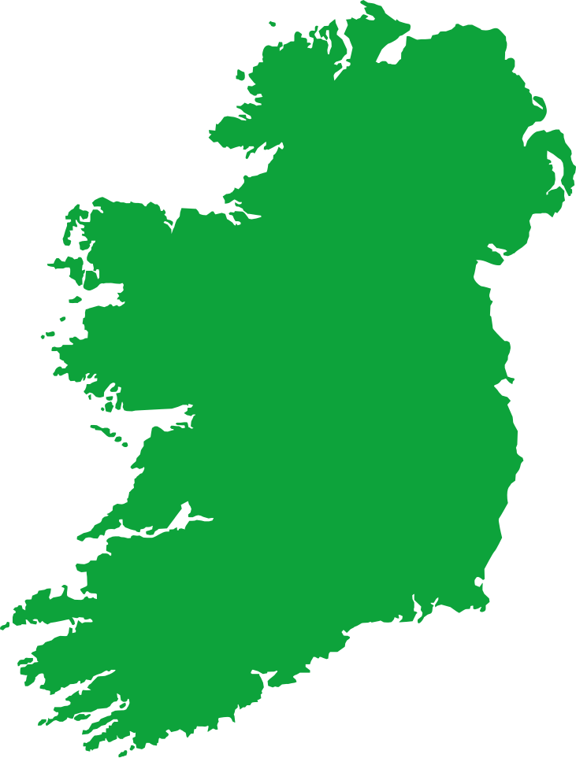
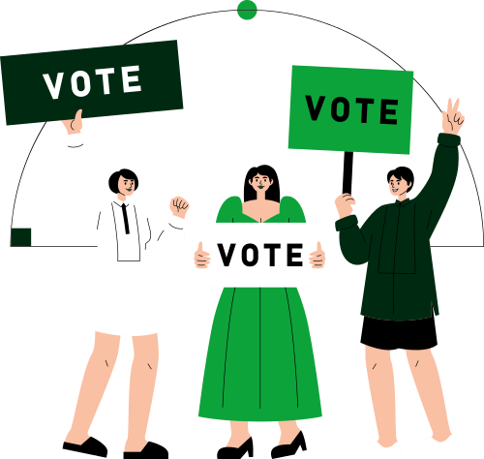
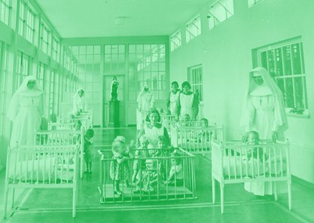
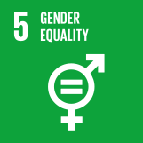
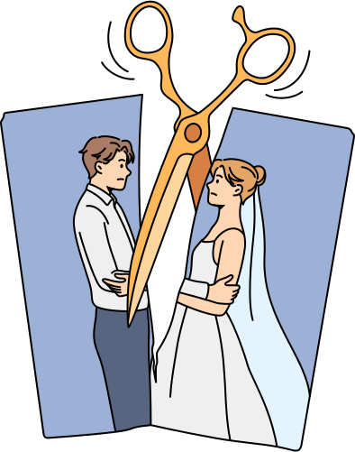
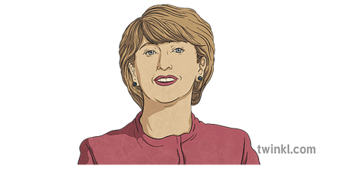


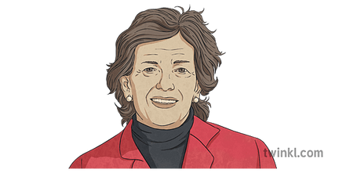
Chapter 29
WOMEN IN 20TH CENTURY IRELAND
Full voting rights for all women, aged 21 and older
The Employment Equality Act is passed, removing gender discrimination in work
Divorce prohibition is repealed; the last Mother and Baby Home is closed
1918
1922
1937
1977
1990
1996
1997
Strand Two: The Nature of History
Chapter Twenty-Nine: Women in 20th Century Ireland
Women, 30 and older, get the right to vote
Divorce is banned by de Valera's conservative government
Mary Robinson is elected as the first female President of Ireland
Mary McAleese is elected as the second female President of Ireland.
@MsDoorley

Slide 3
Learning Outcomes
2.9 EXPLAIN how the experiences of women in Irish society changed during the twentieth century
1.7 DEVELOP historical judgements based on evidence about personalities, issues and events in the past, showing awareness of historical significance
1.9 DEMONSTRATE awareness of the significance of the history of Ireland and of Europe and the wider world across various dimensions, including political, social, economic, religious, cultural and scientific dimensions.
Strand Two: The Nature of History
Chapter Twenty-Nine: Women in 20th Century Ireland
@MsDoorley

Slide 4
Introduction
As Ireland embarked on its struggle for independence, and later, throughout the difficult birth and early years of the Irish state, another struggle for rights was ongoing – those of Irish women. Women had few rights in 1900: no vote, limited access to education and limited employment opportunities. Over the next 100 years, this would change dramatically, largely due to actions taken by women themselves.
Strand Two: The Nature of History
Chapter Twenty-Nine: Women in 20th Century Ireland
@MsDoorley

Slide 5
1900-2000
Chapter 29
29.1: THE EARLY TWENTIETH CENTURY: WOMEN AS SECOND-CLASS CITIZENS
29.1: the early twentieth century: women as second-class citizens
Strand Two: The History of Ireland
@MsDoorley

Slide 6
Getting the Vote
In 1900, women were legally inferior to men; they could not vote, their rights to property and education were limited and discrimination in the workplace was entirely legal. Women across the world saw getting the vote as they key to advancing women’s rights in other areas. The campaign for voting rights was called suffrage and the women who campaigned were called suffragettes.
In 1908, Hanna Sheehy Skeffington founded the Irish Women’s Franchise League (IWFL). It campaigned for votes for women by copying tactics of the suffragettes in Britain: parades, attacks on property and hunger strikes in prison.
Strand Two: The Nature of History
Chapter Twenty-Nine: Women in 20th Century Ireland
@MsDoorley

Slide 7
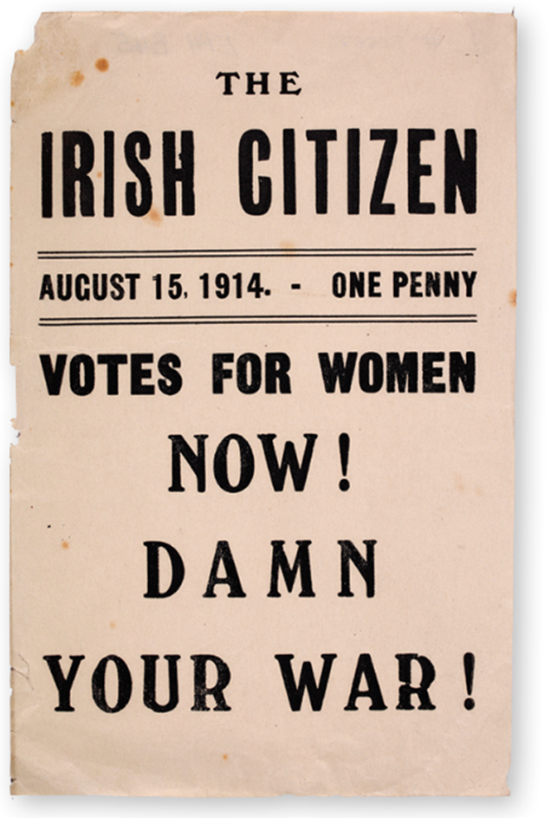
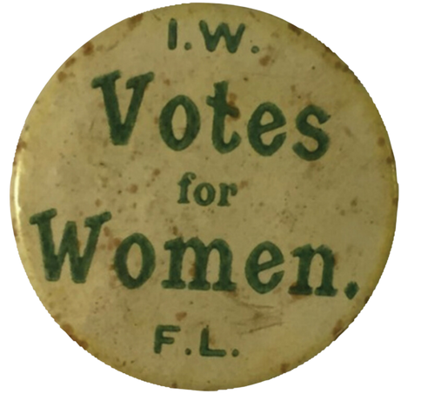
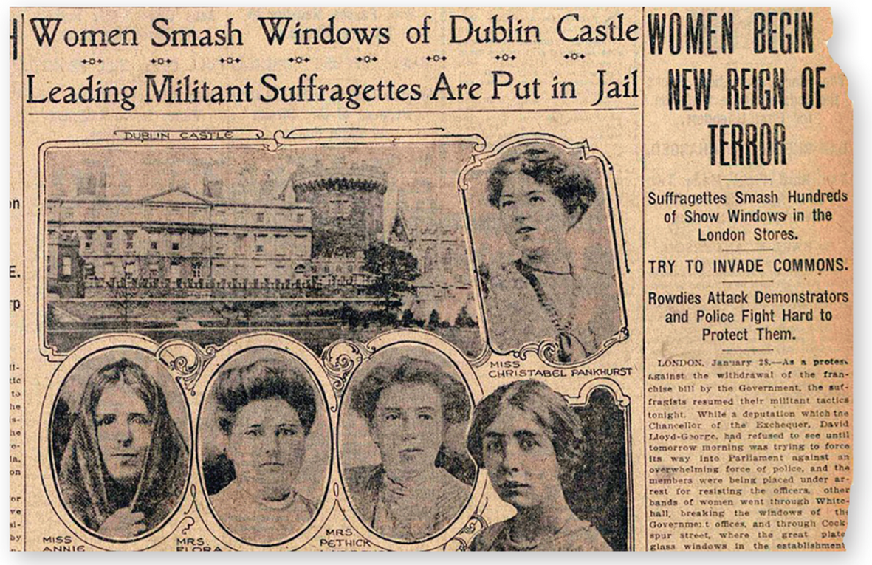
Strand Two: The History of Ireland
Chapter Twenty-Nine: Women in 20th Century Ireland
Diagram taken from Artefact, 2nd Edition by Eimear Jenkinson and Gregg O'Neill (educate.ie)
@MsDoorley

Slide 8
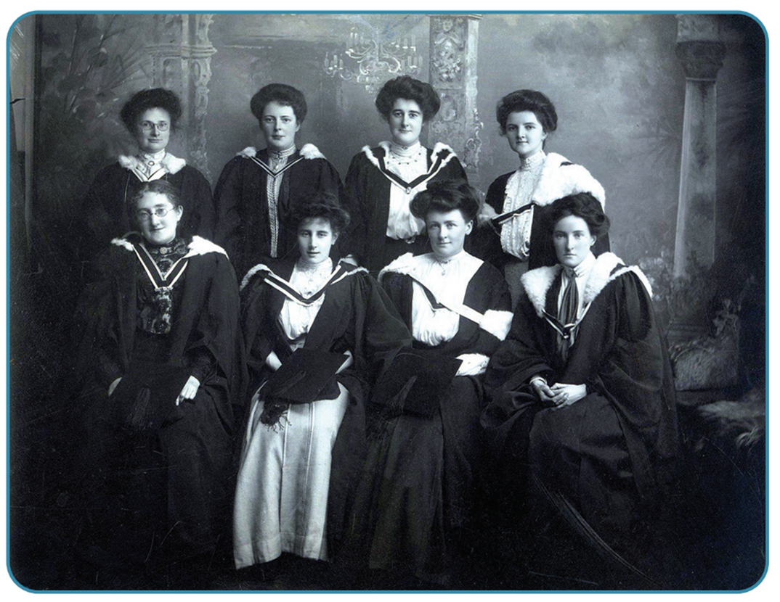
Education
While the number of girls attending school had increased in the 1800s, thanks largely to the efforts of Catholic religious orders, it was only in 1908 that all universities in Ireland were opened to women. In the years afterwards, about 10% of university students were women, but only those from wealthy and middle-class backgrounds. Alice Oldham spearheaded the campaign for the admission of female students to Trinity College, which was finally achieved in 1904. There is now a student prize in her name.
Strand Two: The Nature of History
Chapter Twenty-Nine: Women in 20th Century Ireland
Diagram taken from Artefact, 2nd Edition by Eimear Jenkinson and Gregg O'Neill (educate.ie)
@MsDoorley

Slide 9
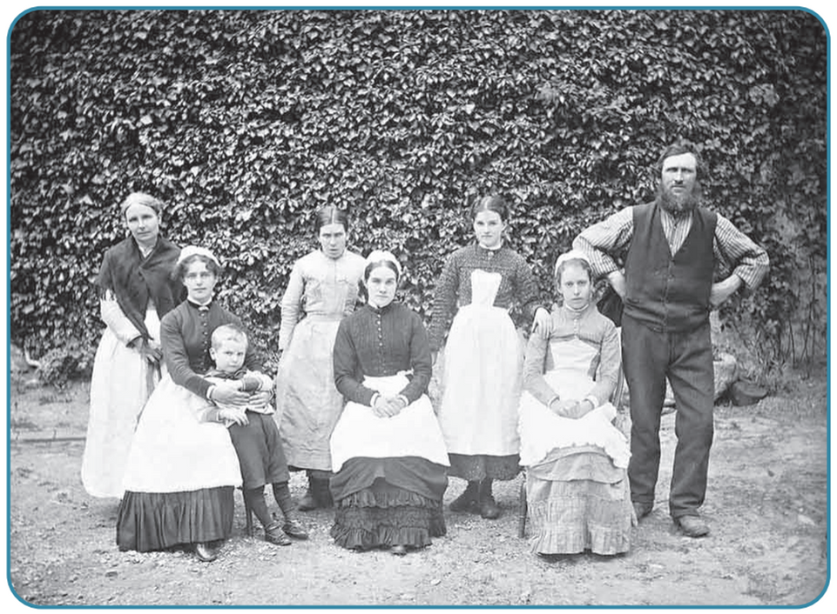
Employment
In the early part of the twentieth century, women were expected to marry and have children. Their husbands would provide for them, so there was no need for them to work. Some women worked before they got married (45% of national school teachers were women) but they had go give up those jobs once married. Most middle-class women did not go out to work but supervised their servants, who did the housework and took care of the children.
Poorer women, especially single ones, often worked outside the home as domestic servants (maids, cooks, nannies), as street traders in larger cities (think Agnes Browne from Mrs Browne’s Boys). In the Belfast mills, they were paid lower wages than men for the exact same work. In rural areas, they were expected to help on the farm as well as run the household and often look after animals.
Strand Two: The Nature of History
Chapter Twenty-Nine: Women in 20th Century Ireland
Diagram taken from Artefact, 2nd Edition by Eimear Jenkinson and Gregg O'Neill (educate.ie)
@MsDoorley

Slide 10
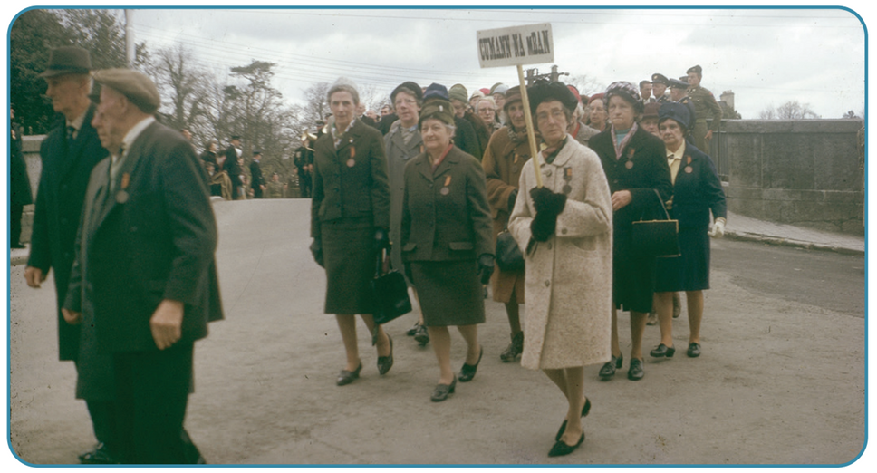
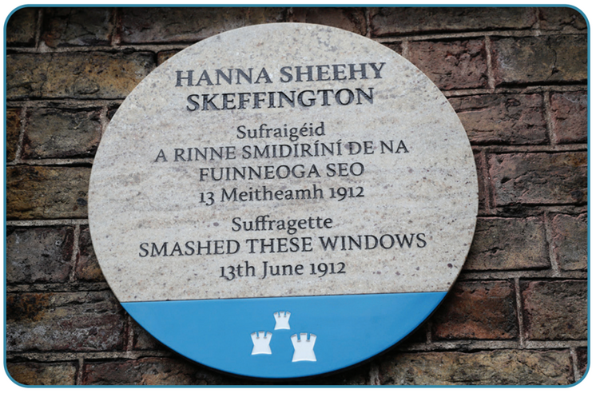
Cumann na mBan
Women were excluded from active involvement in the Home Rule movement, but a women’s organisation, Cumann na mBan, was founded in 1914 to support the independence movement. In 1916, Cumann na mBan became an auxillary force to the Irish Volunteers. During the Easter Rising, several women fought, including Countess Constance Markievicz, Dr Kathleen Lynn and Margaret Skinnider, while others acted as messengers between the rebel bases and nurses inside them, such as Elizabeth O’Farrell. Markievicz would go on to become the first woman to be elected to Westminster in 1918 (she did not take her seat) and later served as Minister for Labour during the First Dáil.
The contributions of women during the struggle for independence were often ignore or denied after 1922. Many were refused military pensions that were granted to men who fought the British.
Strand Two: The Nature of History
Chapter Twenty-Nine: Women in 20th Century Ireland
Diagram taken from Artefact, 2nd Edition by Eimear Jenkinson and Gregg O'Neill (educate.ie)
@MsDoorley

Slide 11
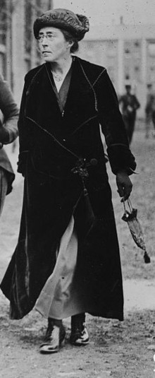
Hanna Sheehy-Skeffington, 1877-1946
Hanna Sheehy was educated at the Dominican Convent in Eccles Street, Dublin, and at the Royal University. When she married Francis Skeffington, they decided to combine their surnames to symbolise equality within their marriage. She became active in radical politics in Dublin, joining Sinn Féin and the Gaelic League and helping to found the Irish Women's Franchise League (IWFL) in 1908 and the Irish Women Workers' Union in 1911. She was arrested several times for her involvement in suffragist protests. She edited the IWFL's newspaper, The Irish Citizen. She was not involved in the 1916 Easter Rising, other than bringing food and messages to the GPO. Her husband, a pacifist and leading opponent of World War I and of British imperialism, was arrested and killed by British soldiers during the Rising. During the War of Independence, Hanna Sheehy-Skeffington toured the USA trying to build support for Irish freedom, and she served as a judge in the Dáil courts. During the Civil War, she opposed the Treaty and joined Fianna Fáil in 1926. In the 1930s, she moved away from Fianna Fáil and edited the IRA's newspaper An Phoblacht. She campaigned against the Fianna Fáil' government's legal limitations on women in the 1930s.
Strand Two: The History of Ireland
Chapter Twenty-Nine: Women in 20th Century Ireland
Diagram taken from Artefact, 2nd Edition by Eimear Jenkinson and Gregg O'Neill (educate.ie)
@MsDoorley

Slide 12
Checkpoint pg. 241 (Artefact, 2nd Edition)
  What is suffrage and what did Irish women do to win it?
  How was Irish women’s access to education limited in the early twentieth century?
  What were employment prospects like for Irish women?
  How were women involved in the struggle for Irish independence?
Strand Two: The Nature of History
Chapter Twenty-Nine: Women in 20th Century Ireland
@MsDoorley

Slide 13
Checkpoint pg. 241 (Artefact, 2nd Edition)
1. Suffrage: the campaign for voting rights; Irish women campaigned for it through parades, attacks on property and hunger strikes in prison.
2. Irish women were only admitted to universities in 1908 and only women from wealthy backgrounds were able to attend.
3. Irish women were expected to marry and have children. Some women worked before they got married but they had to give up those jobs on marriage. Poorer women often worked as domestic servants, street traders and in mills or factories.
4. Cumann na mBan was founded to support Irish independence. Many women fought in 1916 and in the War of Independence.
Strand Two: The Nature of History
Chapter Twenty-Nine: Women in 20th Century Ireland
@MsDoorley

Slide 14
1900-2000
Chapter 29
29.2: INDEPENDENT IRELAND
29.2: independent ireland
2.1 RECOGNISE how a pattern of settlement and plantation influenced identity on the island of Ireland, referring to one example of a pattern of settlement, such as the growth of towns, and one plantation
Strand Two: The History of Ireland
@MsDoorley

Slide 15
Women and politics
The 1922 Constitution of the Irish Free State gave the vote to all women and men over the age of 21. At the same time, the voting age for British women was 30, but only for particularly wealthy women. Very few women were elected to the Dáil in the first decades of the state and those who were made little to no impact. No woman was appointed as a government official since Countess Constance Markievicz until 1979, when Máire Geoghegan-Quinn became Minister for the Gaeltacht. The new Irish state was very conservative, particularly de Valera and his Fianna Fáil party, with the Catholic Church holding a dominant position. The view that a woman’s place is in the home was widespread and accepted by most men and women due to their Catholic upbringing.
  Divorce and contraception was banned.
  Women could not sit on juries.
  The 1937 Constitution recognised a woman’s special role ‘within the home’.
Strand Two: The Nature of History
Chapter Twenty-Nine: Women in 20th Century Ireland
@MsDoorley

Slide 16
Women and employment
After independence, many women continued to work as domestic servants or in low-paid jobs – always for lower pay than men.
  In 1932, a ‘marriage bar’ was introduced: this meant that women automatically lost their jobs in the public service (as teachers or government officials) when they got married. Many employers followed suit and it became accepted that most women would give up work when they married.
  In 1936, the government passed the Conditions of Employment Act, which limited the number of women in any industry.
  When unemployment rose, the first ones to lose their jobs in any industry were almost always women. Trade unions often encouraged employers to pay men more and fire women first.
The result of these measures was that in 1946, only 2.5% of married Irish women were in employment, as opposed to 25% in Britain. It is perhaps no surprise that women emigrated from Ireland at much higher rates than women in the 1940s and 1950s.
Strand Two: The Nature of History
Chapter Twenty-Nine: Women in 20th Century Ireland
@MsDoorley

Slide 17
The institutional abuse of women
The Magdalene Laundries and Mother and Baby Homes were run to house “fallen women” (women who became pregnant outside marriage or did not adhere to Irish society’s social norms) from 1765 to 1996. While there are many records missing, so far there has been over 11,000 women officially recorded to have entered these laundries since 1922. These laundries were quietly supported by the state and were run predominately by Catholic religious orders. A smaller number of these institutions were also run by Protestant orders. The women were sent to these laundries where they were mentally, emotionally and physically abused by the nuns (and priests) as they were forced to complete unpaid labour until their child was born. The women were sent here by their families to avoid public shame on the ‘advice’ of ‘concerned’ people in power such as priests, politicians, judges or gardaí. Women, and their babies, who had died were often buried in unmarked graves such as those in Tuam, Co. Galway or High Park, Drumcondra. Very often the children were put up for adoption without their mothers’ permission and wouldn’t be told that they had been adopted. The last Irish Magdalene laundry closed its doors in 1996. The Irish state formally apologised to the ‘Magdalene women’ in 2013, with then Taoiseach Enda Kenny describing the laundries as Ireland’s ‘national shame’. The Mother and Baby Home survivors received their formal apology in 2021. To this day, many of the remaining survivors are still fighting for compensation and justice for themselves and their families. Many of the Catholic orders responsible for these laundries do not take responsibility for the abuse they caused, nor do they contribute to the financial compensation. Present day Ireland refers to the Magdalene Laundries as a black stain on the history of the Irish state.
Strand Two: The Nature of History
Chapter Twenty-Nine: Women in 20th Century Ireland
@MsDoorley

Slide 18
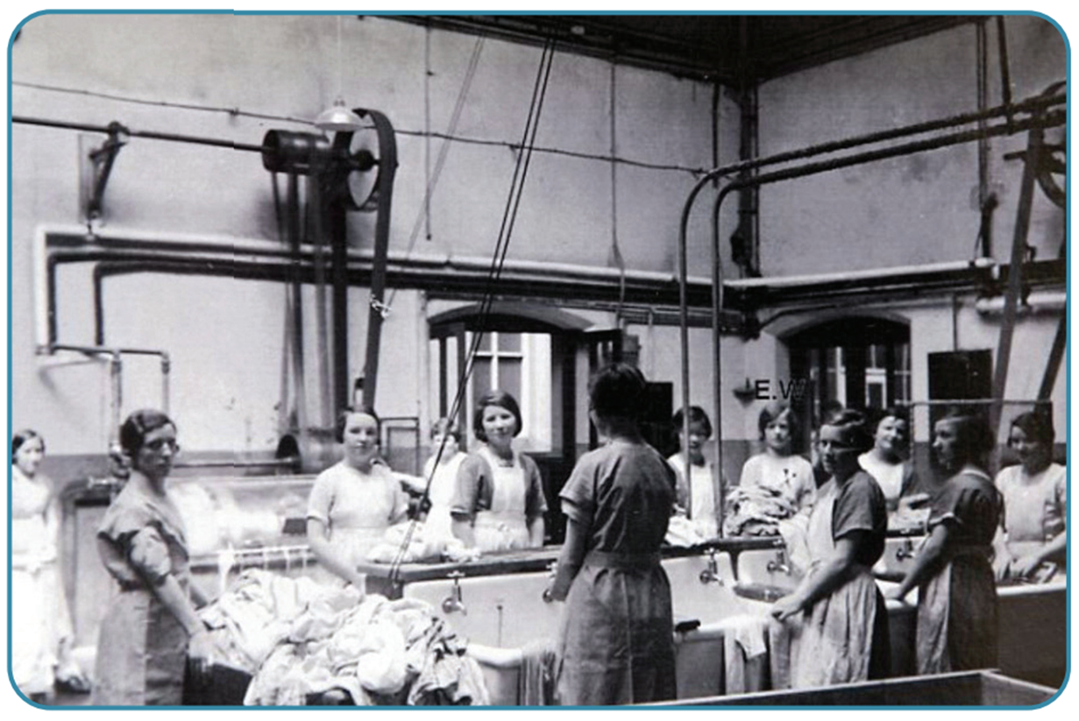
Strand Two: The History of Ireland
Chapter Twenty-Nine: Women in 20th Century Ireland
Diagram taken from Artefact, 2nd Edition by Eimear Jenkinson and Gregg O'Neill (educate.ie)
@MsDoorley

Slide 19
Checkpoint pg. 243 (Artefact, 2nd Edition)
  When did women receive the vote in Ireland?
  What evidence is there that Ireland after independence was a conservative society in terms of women’s rights?
  How did governments in the 1930s restrict women’s access to employment?
  Why do you think that women were forced to give up their jobs when they got married?
  How did these polices affect women in employment?
  What were the Mother and Baby Homes and why were women sent to them?
  What were the Magdalene Laundries and how were women treated there?
  What do you think was the overall impact on Irish women of all the restrictions mentioned in this section?
Strand Two: The Nature of History
Chapter Twenty-Nine: Women in 20th Century Ireland
@MsDoorley

Slide 20
Checkpoint pg. 243 (Artefact, 2nd Edition)
1. 1922 (over the age of 21).
2. The view that a woman’s place is in the home was widespread and accepted by most men and women. Divorce and contraception were banned. Women could not sit on juries. The 1937 Constitution recognised a woman’s special role ‘within the home’.
3. In 1932, a ‘marriage bar’ was introduced, which meant that women automatically lost their jobs in the public service when they got married. In 1936, the government passed the Conditions of Employment Act, which limited the number of women in any industry.
4. It was assumed that they would become mothers and if they were working, it would take away from their real ‘job’ in the home looking after their husband and children.
5. In 1946, only 2.5% of married women were in employment.
6. They were homes run by religious orders where unmarried women and girls were sent to have their babies if they became pregnant. They were sent here because it was not considered acceptable for children to be born outside marriage and these pregnancies had to be kept secret.
7. They were institutions run by religious orders where women and girls considered ‘immoral’ were sent. They were forced to work in laundries and were often beaten, abused and not allowed to leave.
8. Women were very much second-class citizens and expectations were that they would fulfil a role limited to their homes for most of their lives. This led to low levels of female employment and high levels of female emigration.
Strand Two: The Nature of History
Chapter Twenty-Nine: Women in 20th Century Ireland
@MsDoorley

Slide 21
1900-2000
Chapter 29
29.3: MOVES TOWARDS EQUALITY
29.3: moves towards equality
Strand Two: The History of Ireland
@MsDoorley

Slide 22
The 1960s: Gradual Change
As we saw previously, the 1960s were a decade of great change for Ireland and saw the beginnings of positive changes for women. As the economy expanded, more workers were needed. Many of these jobs went to women, who made up 25% of the workforce by 1970. Free education and increased access to universities also benefitted women. New careers were open to women in professions requiring high-level qualifications (for example; doctors, lawyers or engineers). RTÉ was also influential. Shows like The Late Late Show debated controversial topics like marriage breakdown and contraception. Over time, the discussion around these topics would help change attitudes and allowed women more freedom over themselves.
Strand Two: The Nature of History
Chapter Twenty-Nine: Women in 20th Century Ireland
@MsDoorley

Slide 23
The Irish Feminist Movement
Worldwide, the 1960s saw many marginalised groups fighting for more rights, for example African-Americans in the US, Catholics in Northern Ireland and black South Africans. The feminist movement was part of this wider struggle for rights. Feminism is the movement aimed at achieving gender equality, based on political, social and economic equality between men and women. Irish feminists such as Nell McCafferty, Mary Kenny and Nuala O’Faolain founded the Irish Women’s Liberation Movement in 1971. They pressured politicians, held protest marches and organised events to draw attention to the inequality of Irish laws.
  On one occasion, a group took the train to Belfast and brought back contraceptives to protest the law banning them in the Republic. As it happened, they could not get the contraceptive pill, so they bought aspirin instead and swallowed that in front of the cameras, aware nobody in the Republic would know the difference!
  On another, a group went into a pub and ordered 30 whiskeys and one pint of Guinness. When the barman refused to serve them a pint (as many pubs would not do for women), they refused to pay for the whiskeys and left.
Strand Two: The Nature of History
Chapter Twenty-Nine: Women in 20th Century Ireland
@MsDoorley

Slide 24
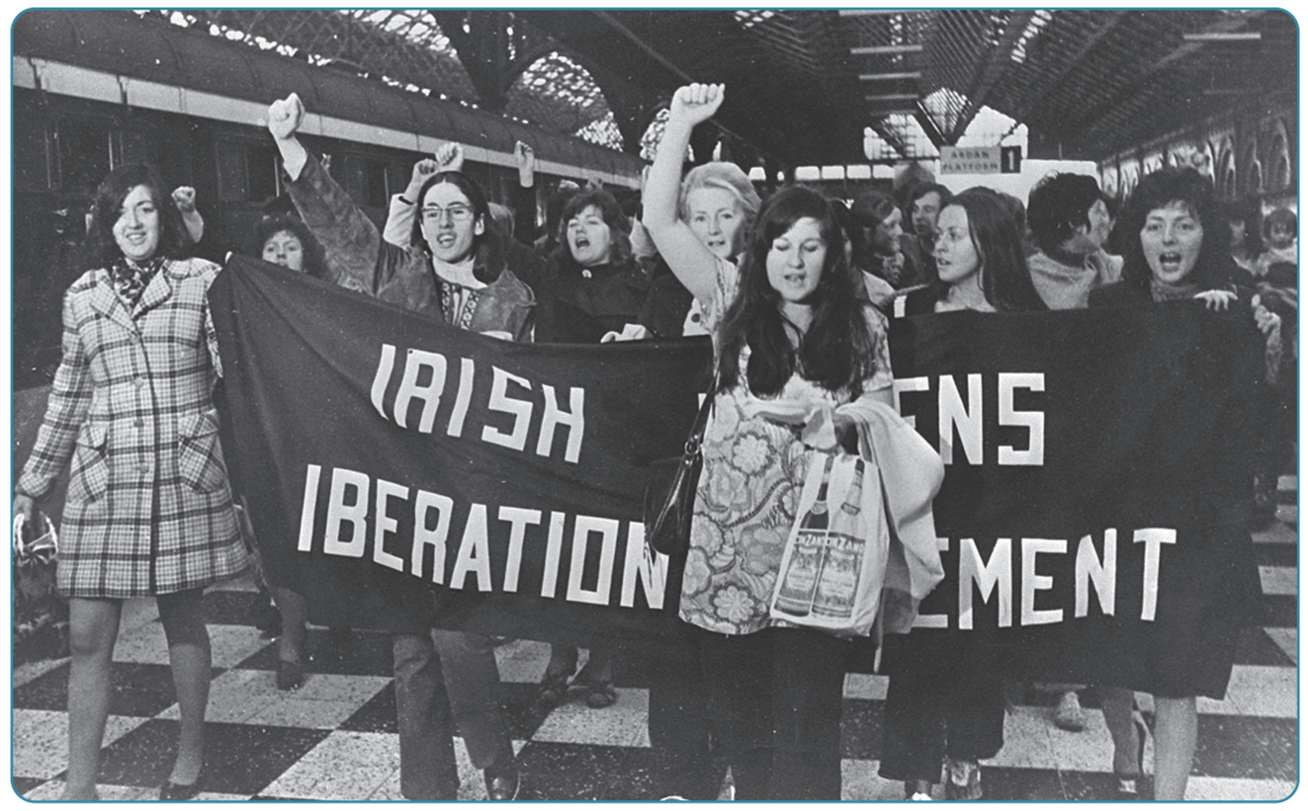
Strand Two: The History of Ireland
Chapter Twenty-Nine: Women in 20th Century Ireland
Diagram taken from Artefact, 2nd Edition by Eimear Jenkinson and Gregg O'Neill (educate.ie)
@MsDoorley

Slide 25
Changes in the 1970s
In 1972, the Commission on the Status of Women recommended the removal of most of the legal barriers to equality. Ireland also came under pressure from the European Community (which it had joined in 1972) to introduce laws to promote equality. Progress continued into the 1980s, 1990s, 2000s and 2010s:
  The ‘marriage bar’ was abolished.
  The Anti-Discrimination Act of 1974 banned paying men more for the same work.
  The Employment Equality Act of 1977 outlawed discrimination on the basis of sex or martial status.
  The ban on contraception was lifted gradually in 1978 and 1985 before abolished altogether in 1993.
  Divorce was reintroduced in 1996.
Strand Two: The Nature of History
Chapter Twenty-Nine: Women in 20th Century Ireland
@MsDoorley

Slide 26
The position of women at the end of the century
By 2000, women made up over 40% of the workforce but were far more likely to hold low-paid positions. A low percentage of employed women held high-paid executive positions. However, women did make up 55% of university students in 2000 and were more likely to purpose professional careers in law, medicine, business or education than their mothers had been.
In politics, there has been some progress towards equality; Mary Robinson was elected President in 1990, followed by another woman, Mary McAleese in 1997. In 2011, Susan Denham became Ireland’s first female Chief Justice of the Supreme Court. In 1993, Mary Harney became the first woman to lead a political party, the Progressive Democrats, and also the first female Tánaitse in 1997. Three other women have served as Tánaiste: Mary Coughlan (2008-2010), Joan Burton (2014-2016) and Frances Fitzgerald (2016-2017). However, there has not yet been a female Taoiseach.
Women have made significant advances in other areas too. Olivia O’Leary became a prominent broadcaster in RTÉ news programmes in the 1980s, opening the door for other women. In sport, athlete Sonia O’Sullivan and boxer Katie Taylor won medals in the World Championships and the Olympics, with Taylor later turning professional and succeeding in that area as well.
These (and many other) women’s recognised excellence in their fields paved the way for younger generations to strive for success and to expect the same opportunities and respect as men.
Strand Two: The Nature of History
Chapter Twenty-Nine: Women in 20th Century Ireland
@MsDoorley

Slide 27
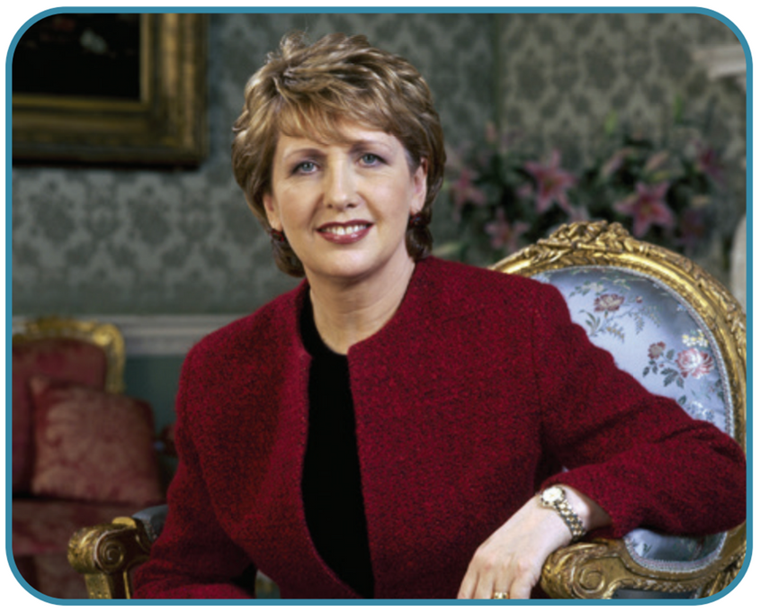
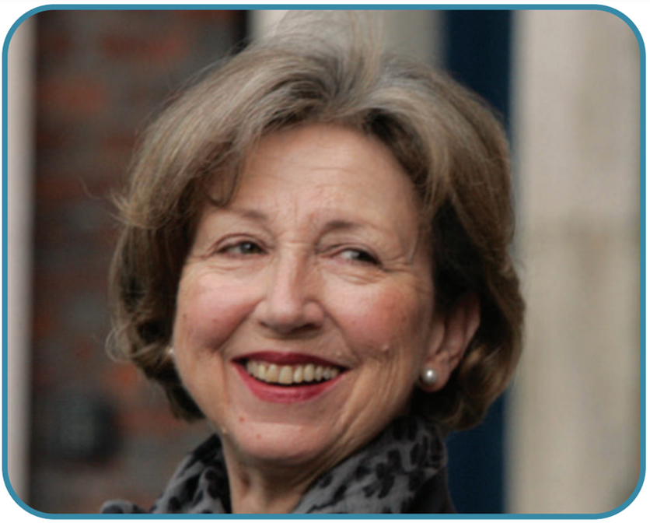
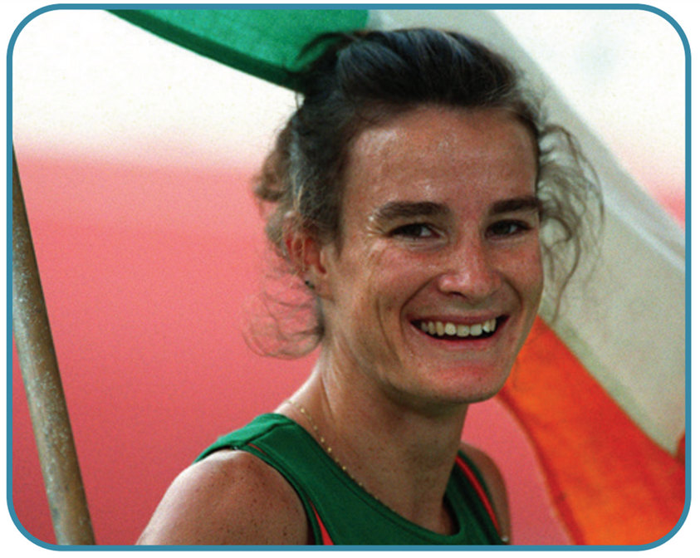
Strand Two: The History of Ireland
Chapter Twenty-Nine: Women in 20th Century Ireland
Diagram taken from Artefact, 2nd Edition by Eimear Jenkinson and Gregg O'Neill (educate.ie)
@MsDoorley

Slide 28
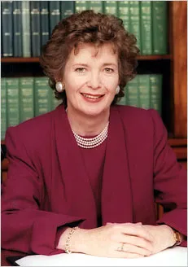
Mary Robinson, 1944-
Mary Robinson (née Bourke) was born in Ballina, Co. Mayo, in 1944. She studied law at Trinity College, King’s Inns and Harvard Law School and became a Reid Professor in Trinity College in the 1960s. Robinson was elected to Seanad Éireann as an independent in 1969. She campaigned on women’s rights by working to remove the ban on contraceptives and the marriage bar. She supported the introduction of divorce and opposed the 1983 anti-abortion amendment to the Constitution. As a leading barrister, she brought cases to the Irish and European courts that established the right to free legal aid, gay rights and the protection of the Viking site at Wood Quay. Robinson was elected President in 1990. Her victory was seen as a huge symbolic step forward for Irish women as well as for the liberation of Irish society. As President, she opened up the office, visiting groups all over the country and inviting others to Áras an Uachtaráin. She reached out to marginalised groups at home and abroad: the Traveller Community, LGBT people, Irish emigrants, the homeless and African victims of famine and war. She helped the Northern peace process by meeting Sinn Féin’s Gerry Adams and was the first Irish President to meet Queen Elizabeth II. In 1997, she was appointed the UN High Commissioner for Human Rights. Mary Robison has been one of The Elders (an international group of public figures devoted to peace and human rights worldwide) since 2007 and also founded a climate justice organisation.
Strand Two: The History of Ireland
Chapter Twenty-Nine: Women in 20th Century Ireland
@MsDoorley

Slide 29
Checkpoint pg. 246 (Artefact, 2nd Edition)
  How did Irish women benefit from the changes of the 1960s?
  What is feminism and how was Ireland influenced by it?
  What legal changes occurred for Irish women in the 1970s?
Strand Two: The Nature of History
Chapter Twenty-Nine: Women in 20th Century Ireland
@MsDoorley

Slide 30
Checkpoint pg. 246 (Artefact, 2nd Edition)
1. As the economy expanded, more women got jobs. They had greater access to education and therefore also to professional careers. RTÉ was also influential in beginning to change attitudes towards a woman’s role in society.
2. Feminism: the movement aimed at achieving gender equality, based on political, social and economic equality between men and women. The Irish Women’s Liberation Movement was set up in 1971 and pressed for changes to laws that discriminated against women.
3. The ‘marriage bar’ was abolished; the Anti-Discrimination Act of 1974 made it illegal to pay men more than women for the same work; the Employment Equality Act of 1977 outlawed discrimination on the basis of sex or marital status; the ban on contraception was gradually lifted.
Strand Two: The Nature of History
Chapter Twenty-Nine: Women in 20th Century Ireland
@MsDoorley

Slide 31
1900-2000
Chapter 29
29.4: SUMMARY
29.4: summary
Strand Two: The History of Ireland
@MsDoorley

Slide 32
In this chapter, we have learned that...
  Up until 1922, women had little say over their lives or their country, as they did not have the cote, were relegated to poorly paid jobs and had little access to education.
  Despite playing an important role in the independence struggle and winning the vote in 1922, women were discriminated against by a series of Irish laws, and even the Constitution declared their proper place to be ‘in the home’.
  This situation did not start to change until the 1960s, when greater employment and educational opportunities opened up for women.
  The feminist movement in Ireland pushed for change and achieved important legal reforms in the 1970s and 1980s.
  The 1990s saw important symbolic firsts in politics with women elected as party leaders, as presidents and as Tánaistí.
Strand Two: The History of Ireland
Chapter Twenty-Nine: Women in 20th Century Ireland
@MsDoorley

Slide 33
Reflecting on... Women in 20th Century Ireland
The history of Irish women over the last century is an illustration of a lesson often repeated in wider world history: Marginalised groups cannot wait for their rights to be handed to them but must fight for them themselves. Legal changes may happen relatively quickly (for example, getting the vote) but it takes far longer to change society. To this day, many marginalised groups are still fighting for basic human rights throughout the world. While we have come a long way in many regards, there is still a long way to go before all humans are considered equal through law and society.
Strand Two: The History of Ireland
Chapter Twenty-Nine: Women in 20th Century Ireland
@MsDoorley

Slide 34
SEC Examination Questions
2023 SEC Q8
Strand Two: The History of Ireland
Chapter Twenty-Nine: Women in 20th Century Ireland
@MsDoorley

Slide 35
Project
Guidelines:
  Length: The depth of your project should reflect about 2-3 weeks of work.
  Sources: Use at least three different sources for your research. These can be books, scholarly articles, or reputable online resources.
  Citations: All information and images that are not your own should be properly cited.
  Mediums: You may choose to present your project in one of the following ways:
    Poster: Your poster should be informative and visually engaging.
    Minecraft or Lego Model: If choosing this option, please also include a brief report explaining your model.
    Painting/Drawing: Your artwork should be accompanied by a description.
    Recycled Materials: Create your model using recycled materials and provide an explanation of your creative process.
Assessment:
Your projects will be assessed based on:
  Research and Content
  Creativity and Presentation
  Understanding of Context
  Adherence to Guidelines
Strand Two: The History of Ireland
Chapter Twenty-Nine: Women in 20th Century Ireland
@MsDoorley

Slide 36
Project
Historical Sites
Historical Figures
Hanna Sheehy-Skeffington Building, University College Dublin
Cumann na mBan Memorial, Glasnevin Cemetery, Dublin
Irish Women Workers' Union Headquarters, Dublin
Magdalene Laundry Site, Dublin
Leinster House, Dublin, Republic of Ireland
Louie Bennett
Elizabeth Bowen
Kathleen Clarke
Margaret Burke Sheridan
Bernadette Devlin
Mauriel Gahan
Grace Gilfford Plunkette
Maud Gonne McBride
Nora Herlihy
Mainie Jellett
Mary Lavin
Mary Robinson
Mary McAleese
Mary MacSwiney
Constance Markievicz
Patricia McCluskey
Peig Sayers
Hanna Sheehy Skeffington
Elizabeth O’Farrell
Jennie Wyse Power
Sonya O’Sullivan
Katie Taylor
Kellie Harrington
Maureen O’Hara
Saoirse Ronan
Ruth Negga
Katie McGrath
Derval O’Rourke
Angela Downey
Anna Geary
Stephanie Roche
Katie McCabe
Strand Two: The History of Ireland
Chapter Twenty-Nine: Women in 20th Century Ireland
@MsDoorley

